Slide 1
survey Research
Prof. Richard Torkar
Dr. Wasif Afzal

Slide 2

contents
The survey process:
Defining objectives
Sampling strategy
Mode of data collection
Survey instrument
Reliability and validity of survey instrument
Pretesting the instrument
Data analysis and interpretation

Slide 3
But first some nomenclature and definitions

Slide 4
What is a survey?
A survey design provides a quantitative or numeric description of trends, attitudes, or opinions of a population by studying a sample of that population [Creswell, 2014].
[...] the concerns involved in doing a survey are [...] to do with the detailed design of the instrument to be used (almost always a questionnaire, largely or wholly composed of fixed-choice questions), determining the sample to be surveyed and ensuring high response rates [Robson, 2002].
A survey is not just the instrument (the questionnaire or checklist) for gathering information. It is a comprehensive system for collecting information to describe, compare or explain knowledge, attitudes and behavior. [Pfleeger and Kitchenham, 2001].

Slide 5
Features of survey
The use of fixed, quantitative design (non-experimental);
The collection of a small amount of data in standardized form from a relatively large number of individuals;
The selection of representative samples of individuals from known populations.
n > p (n < p for interviews)

Slide 6
Features of survey
Surveys work best with standardized questions.
Surveys can provide a wide range of ‘people characteristics’, and of relationships (correlations) between such characteristics.
Purpose is to generalize from a sample to a population so that inferences can be made about some characteristic, attitude, or behavior of this population.
Identification of causal relationships is difficult (correlation does not imply causation).

Slide 7
Types of survey
Supervised vs. Unsupervised
Supervised: Assigning a survey researcher to one or a group of respondents.
Unsupervised: E.g., mailed questionnaire.

Slide 8
Types of survey
Cross-sectional vs. Longitudinal
Cross-sectional survey:
Collects information from a sample of the population at a specific point in time, even though it could take days to gather all the data.
If you survey everyone in the population, that is known as a census.

Slide 9
Types of survey
Longitudinal Survey:
Information is collected at different points in time to study change over time.
Cohort studies: Samples a group experiencing an event in a selected time period and studying them at different time intervals.
Panel studies: A sample is drawn from a population and those same individuals are studied over time (usually at regular intervals with at least t = t₁,..,t₂).

Slide 10
The survey process
Formulate research questions or objectives.
Identify the population to be studied.
Select the sample.
Choose the mode of data collection (Mail surveys, Electronic surveys, Direct administration to a group, Telephonic surveys, Personal interviews).
Construct the survey instrument.
Pretest the survey instrument and establish reliability/validity.
Data analysis & Interpretation

Slide 11
1. Setting Survey objectives
A statement of survey’s expected outcomes.
Setting objectives is important because:
Objectives determine what the survey will ask, of what population, and what information will be collected.
Objectives are usually phrased as research questions or hypotheses, and they help suggest dependent and independent variables.

Slide 12
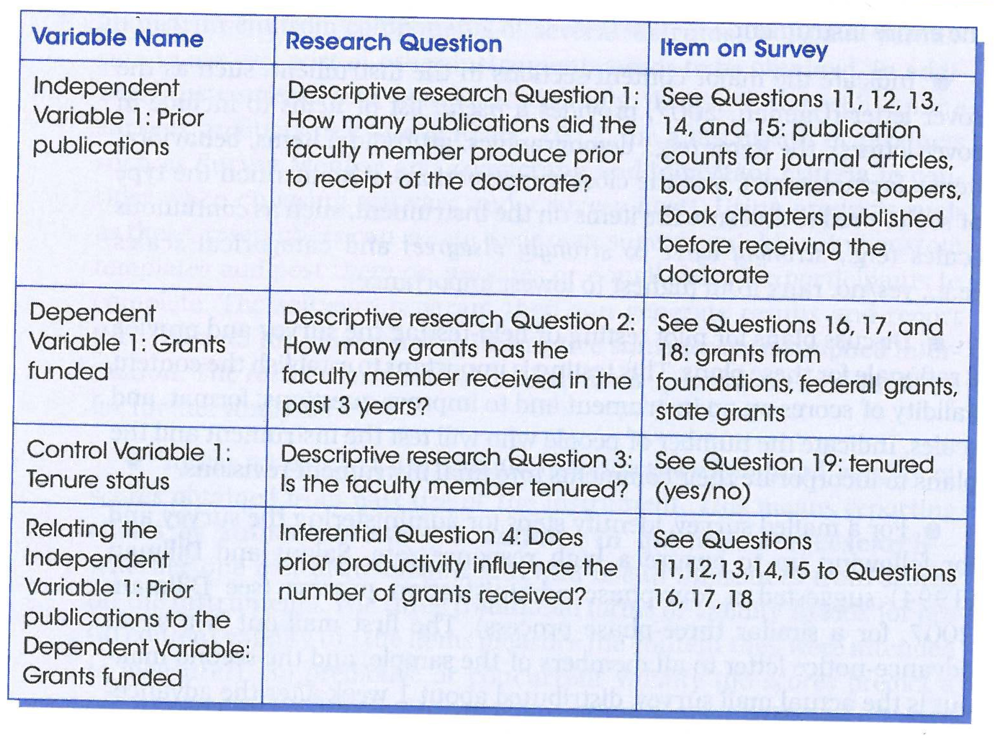
A good practice

Slide 13
2-3: Sample & population
Population: the group of individuals to whom the survey applies.
Sample: A representative subset of population such that the results from this subset generalize to target population.

Slide 14
Population identification
Should arise from survey objectives/research questions
Example: Software developers doing object-oriented software development

Slide 15
Sample identification
Probabilistic sampling methods:
Simple random sampling (preferred)
Stratified random sampling
Non-probabilistic sampling methods:
Convenience sampling
If we need to make strong inferences to the target population, we need a probabilistic sampling method.

Slide 16
Simple random sampling
A sample in which every member of the target population has the same probability of being included in the sample.
Use a random number generator to assign a random number to each member of the target population (https://www.random.org)
Order the members on the list according to the random numbers.
Choose the first n members on the list where n is the required sample size.

Slide 17
Stratified random Sampling
The target population is divided into subgroups called strata.
Each stratum is sampled separately.

Slide 18
Convenience sampling
Obtaining response from those people who are available and willing to take part

Slide 19
Sample size
If the sample size is not big enough, we cannot come to a reasonable conclusion, and we can not generalize to target population.
Borg and Gall (1989) recommend about 100 observations for each of the major sub-groupings in the survey, with 20 to 25 for minor sub-groupings.

Slide 20
Sample size
Fowler (2009) presents a table to look up sample sizes. It requires three elements:
Determine the margin of error you are willing to tolerate (say +/-4% confidence interval).
Determine the confidence level for this margin of error (say 95 out of 100 times, or a 5% chance).
Estimate the percentage of your sample that will respond in a given way (50% with 50/50 being the most conservative because people could respond either way).

Slide 21
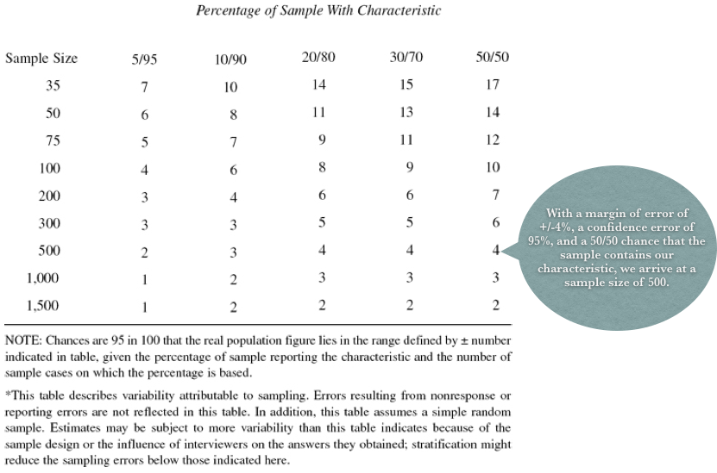
Sample size

Slide 22
4. Mode of data collection
Mail Surveys:
Best for sensitive items but not open-ended questions.
Lack of control over respondent interaction with unknown others while responding.
Often used for very short instruments.

Slide 23
Mode of data collection
Direct administration to a group:
Used when researcher has access to all or most of the members of a particular group in one place.
Researcher can explain the study and answer questions.
Close to 100% response rate.

Slide 24
Mode of data collection
Personal interview
Can support longer instruments.
Slow data collection time.
Used when in-depth exploration of opinions is required.

Slide 25
Mode of data collection
Electronic surveys
Fast in data collection and takes less time in implementation.
Can be administered to large populations.
Not optimal for long surveys or with open-ended questions.
Near-impossibility of drawing random samples.

Slide 26
Mode of data collection
Telephone surveys
Has the advantage of speed of data collection while supporting longer instruments than mail surveys.
It supports open-ended responses, though not as well as face-to-face interviewing.

Slide 27
5. Constructing the survey instrument
Survey instruments are usually questionnaires.
Questions can be expressed as open and closed.

Slide 28
Open Questions
A question is open when the respondents are asked to frame their own reply.
It avoids imposing any restrictions on the respondent.
Open questions have room for misinterpretation and provision of an irrelevant or confusing answer.
Open questions are difficult to code and analyze.

Slide 29
Analyzing open questions
Codes | Identifying anchors that allow the key points of the data to be gathered
Concepts | Collections of codes of similar content that allows the data to be grouped
Categories | Broad groups of similar concepts that are used to generate a theory
Theory | A collection of categories that detail the subject of the research

Slide 30
Closed Questions
Closed questions limit respondents’ choice of reply, e.g., ordered categorical (Likert) and categorical (0/1).
Easier to analyze.
Two scale types are most common:
Continuous/ordinal scale: Strongly Agree to Strongly Disagree.
Categorical scale: -- Yes/No (Don’t Know)

Slide 31
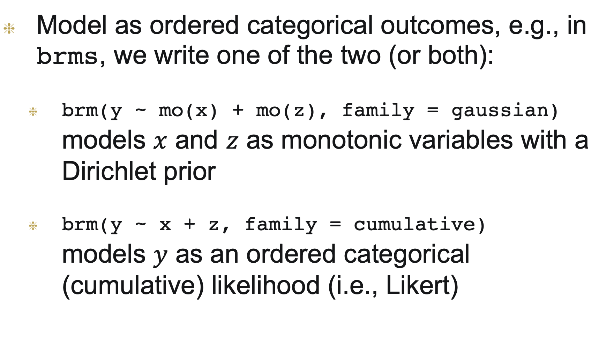
Analyzing closed questions
Model as ordered categorical outcomes, e.g., in brms, we write one of the two (or both):
brm(y ~ mo(x) + mo(z), family = gaussian) models $x$ and $z$ as monotonic variables with a Dirichlet prior
brm(y ~ x + z, family = cumulative) models $y$ as an ordered categorical (cumulative) likelihood (i.e., Likert)

Slide 32
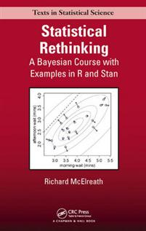
Rethinking II
Ch 12 in Edition 2 provides examples where outcome and predictors are ordered categorical:
m12.5 <- ulam( alist( R ~ ordered_logistic(phi, kappa), phi <- bE*sum(delta_j[1:E]) + bA*action + bI*intention + bC*contact, kappa ~ normal(0, 1.5), c(bA,bI,bC,bE) ~ normal(0, 1), vector[8]: delta_j <<- append_row(0, delta), simplex[7]: delta ~ dirichlet(alpha) ), data=d)

Slide 33
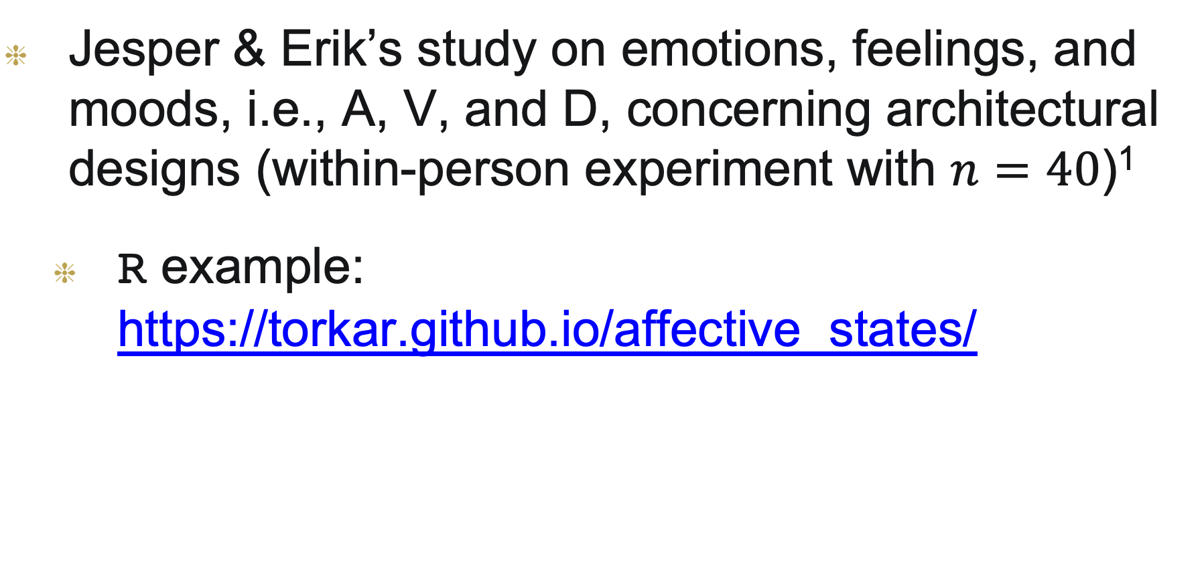
AN EXAMPLE (2020)
Jesper & Erik’s study on emotions, feelings, and moods, i.e., A, V, and D, concerning architectural designs (within-person experiment with $n=40$)¹
R example: https://torkar.github.io/affective_states/
1. https://statmodeling.stat.columbia.edu/2019/11/16/why-do-a-within-person-rather-than-a-between-person-experiment/

Slide 34
Guidelines for constructing a survey instrument
Try searching for relevant questionnaires and adapt.
Easier to compare results.
SE surveys are usually developed from scratch.
Questions should relate directly to RQs/objectives, hence should be purposeful.
Questions should be easily understood and answerable so understand your respondents.
Ask an appropriate number of questions: (1) Group into topics and prune (2) Use standardized response format.
Avoid two-edged questions.
Use conventional language; avoid use of abbreviations & slang.
Avoid using negative questions as they are difficult to understand.

Slide 35
Reliability & validity
Reliability: A survey is reliable if we administer it many times and get roughly the same distribution of results each time.
Validity: How well the survey instrument measures what it is supposed to measure?

Slide 36
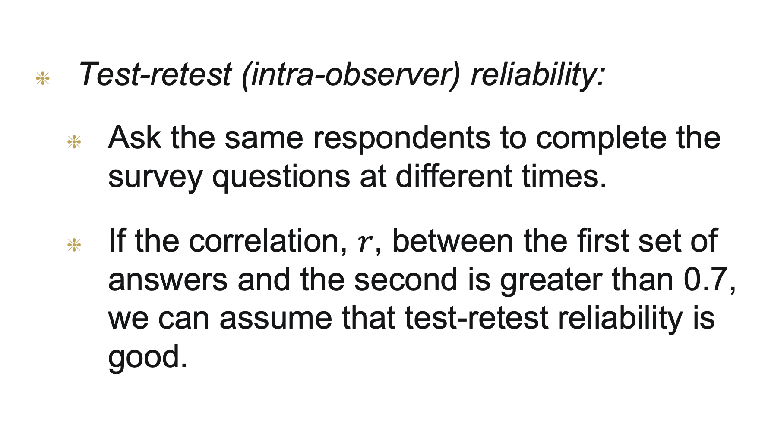
Types of reliability
Test-retest (intra-observer) reliability:
Ask the same respondents to complete the survey questions at different times.
If the correlation, $r$, between the first set of answers and the second is greater than 0.7, we can assume that test-retest reliability is good.

Slide 37
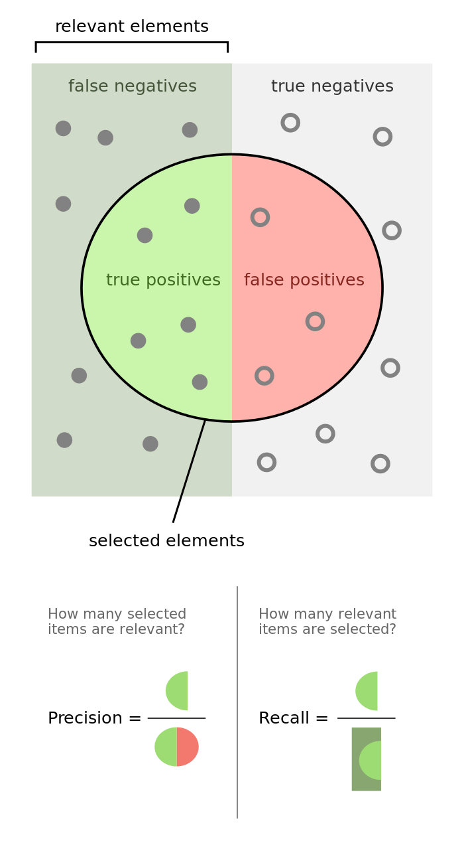
Types of reliability
Alternate form reliability:
Test-retest reliability suffers from practice effect and recall problems.
Solution: Give the same respondents different versions of the questionnaire with questions being reworded or reordered.

Slide 38
Types of reliability
Internal consistency:
Ask group of questions that measure different aspects of the same concept.
We want to make sure that these aspects are consistent with respect to the overall concept.

Slide 39
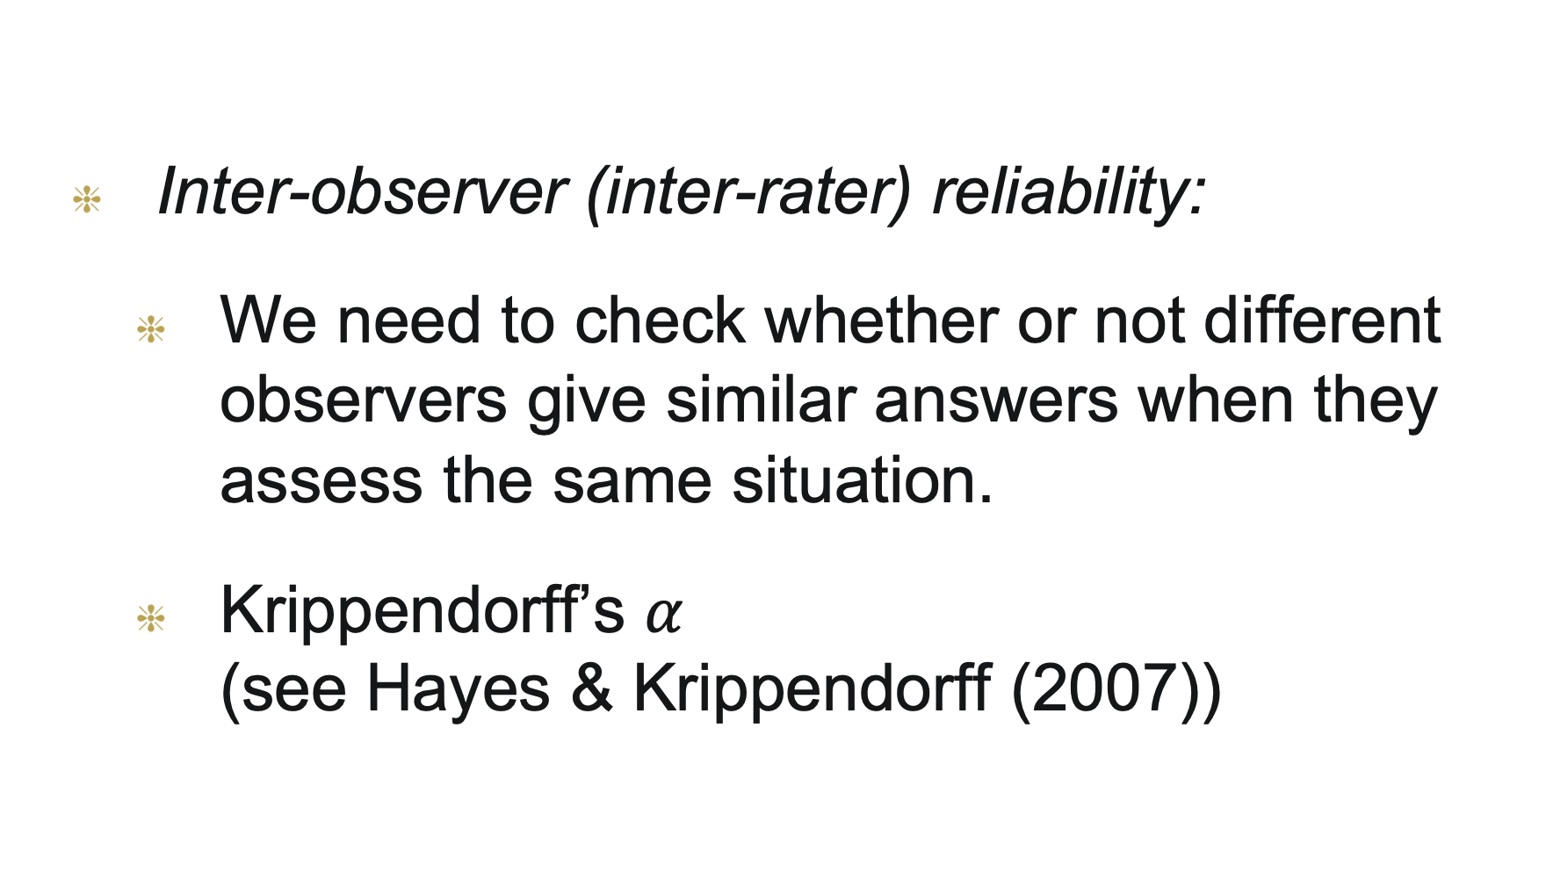
Types of reliability
Inter-observer (inter-rater) reliability:
We need to check whether or not different observers give similar answers when they assess the same situation.
Krippendorff’s $α$ (see Hayes & Krippendorff (2007))

Slide 40
Types of validity
Content validity
Subjective assessment of how appropriate the instruments seems to a group of reviewers with knowledge of the subject matter.
Criterion validity
Compares one instrument to another instrument.

Slide 41
Types of validity
Construct validity
Assess the extent to which different data collection approaches produce similar results.
Often requires many years of experience to assess it.

Slide 42
6. Survey instrument evaluation/Pre testing
Two most common ways of evaluation:
Focus groups
Pilot studies

Slide 43
Focus groups
Assemble a group of people representing respondents, experts, beneficiaries of survey results.
Ask them to complete the survey questionnaire.
The group identifies missing or unnecessary questions, ambiguous questions and instructions.

Slide 44
Pilot studies
Uses the same procedures as planned for the main study but with smaller sample.
Targets not only problems with questions but also response rate and reliability assessment.

Slide 45
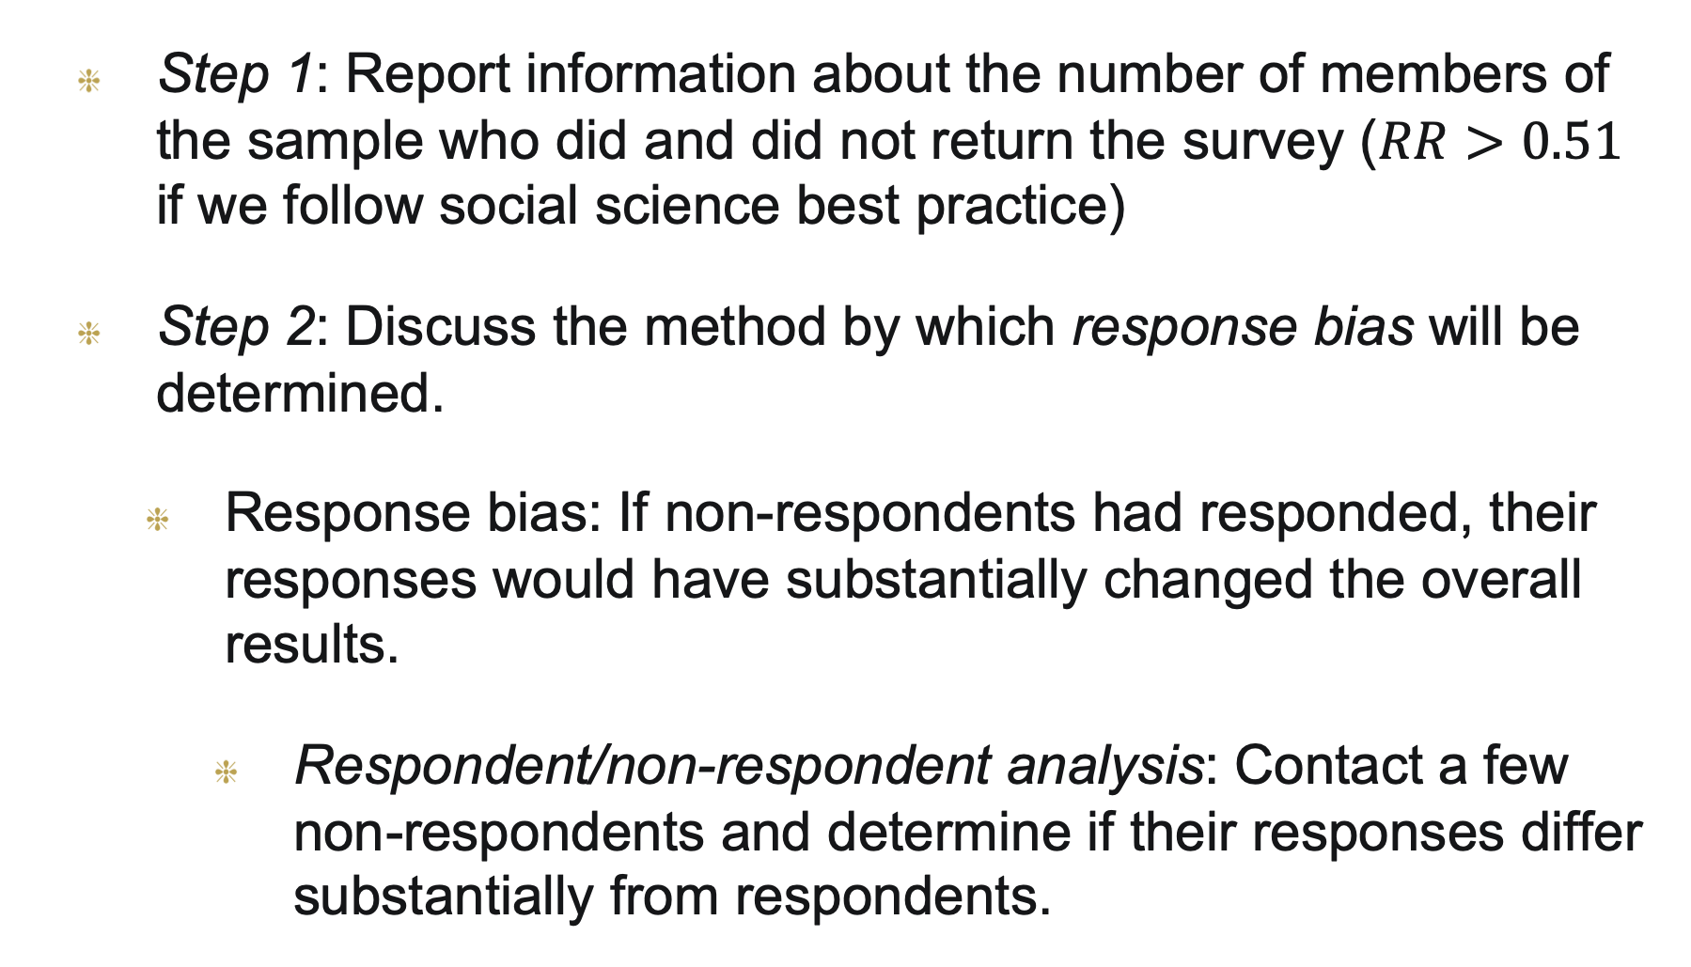
7. Data analysis & interpretation
Step 1: Report information about the number of members of the sample who did and did not return the survey ($RR>0.51$ if we follow social science best practice)
Step 2: Discuss the method by which response bias will be determined.
Response bias: If non-respondents had responded, their responses would have substantially changed the overall results.
Respondent/non-respondent analysis: Contact a few non-respondents and determine if their responses differ substantially from respondents.

Slide 46
Data analysis & interpretation
Step 3: Provide a descriptive analysis of data for all independent and dependent variables in the study (means, standard deviations, range).
May want to partition the responses and report results for different subgroups.
Step 4: Decide on data coding for applying statistical tests.
If data is approximately normal, ordinal data can be converted to numerical values (continuous).

Slide 47
Data analysis & interpretation
Step 5: Identify the statistics for testing the major inferential research questions or hypotheses. Inferences.
You know what to do if you’ve passed the course!

Slide 48
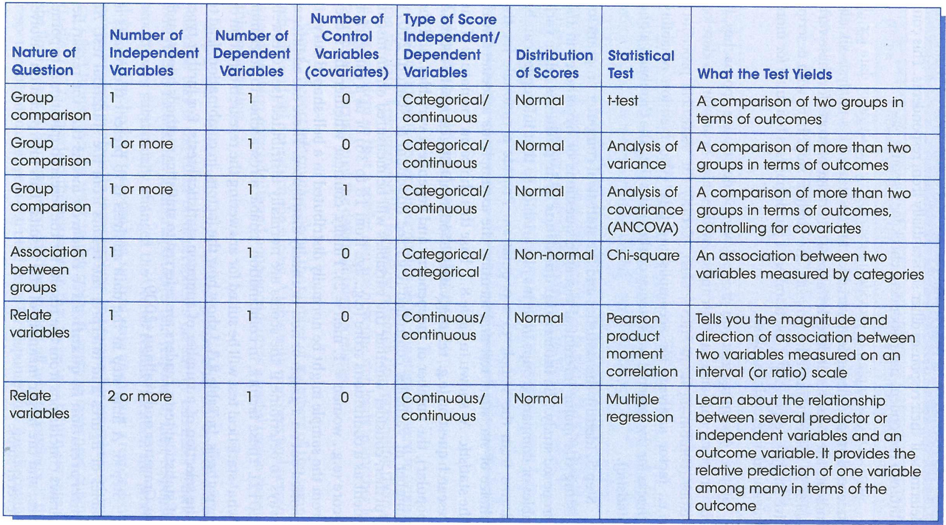

Data analysis & interpretation

Slide 49
Data analysis & interpretation
Step 6: Present the results in tables or figures and interpret the results from the statistical test (if needed!)
Report extensive description, statistical significance testing (if needed!), credible/compatible intervals and effect sizes.
Step 7: Discuss the implications of your research for practice and for future research on the topic.

Slide 50
References
[Borg and Gall, 1989] Borg, W. R. and Gall, M. D. (1989) Educational research. White plains, NY: Longman
[Creswell, 2014] J.W. Creswell. Research design–Qualitative, Quantitative, and Mixed Method Approaches. Sage Publications. 2014
[Fowler, 2009]. Fowler, F. J. Survey research methods (4th ed.). Thousand Oaks, CA: Sage
[Hayes and Krippendorff, 2007] Hayes, A. F. and Krippendorff, K. Answering the call for a standard reliability measure for coding data. Communication Methods and Measures, 1:1, 77–89, DOI: 10.1080/19312450709336664
[Pfleeger and Kitchenham, 2001] Pfleeger and B. Kitchenham. Principles of survey research. Part 1–6. Software Engineering Notes, 2001–2003
[Robson, 2002] C. Robson. Real world research. 2nd Edition. Blackwell Publishing. 2002

